Slide 1
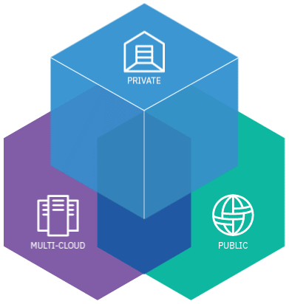
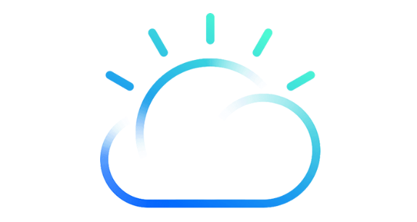
IBM Cloud Private
Đặng Hải Nam
HIS – P.GPHT

Slide 2
IBM Cloud Private
Concept
Features
Architecture
Docker

Slide 3
IBM Cloud Private
1. Concept
IBM Private Cloud is:
An application platform for developing and managing on-premises.
Containerized applications.
An integrated environment for managing containers that includes:
Kubernetes for orchestrator.
A private image repositoty.
A management console.
Monitoring frameworks.

Slide 4
IBM Cloud Private
2. Features
A unified installer: Rapidly deploy your cluster
IBM Cloud Private cluster management console: manage, monitor, troubleshoot
Private Docker image registry.
Catalog with Helm: https://github.com/kubernetes/charts/tree/master/stable.
Isolated Tenant Networks with Calico: Virtual network and more.
Robust monitoring and logging with ELK stack: Elasticsearch, Logstash, Filebeat and Heapster

Slide 5
IBM Cloud Private
3. Architecture
An IBM Cloud Private cluster has four main classes of nodes:
Boot node.
Master node.
Worker node.
Proxy Node.
Management Node.

Slide 6
IBM Cloud Private
4. Editions

